Slide 1


Financial Literacy Training
Financial Literacy Course
Notes:
Change It

Slide 2
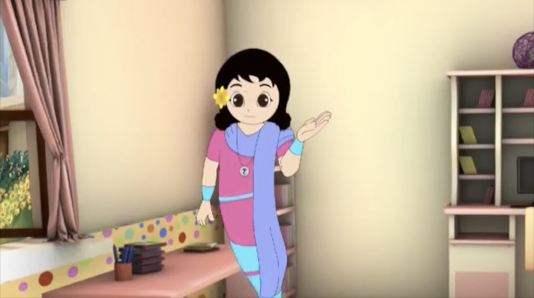
Video - Ginni
Play the Video

Slide 3



Emergencies
Unexpected Expenses like
Illness, accident, death
Why Savings are needed?
Future Needs
Large Expenses
With savings, in the future
you can buy what you can
not buy today
To meet larger expenses
like purchasing a house, marriage,
education
Notes:
Additional Explanatory images for each item

Slide 4


Drawbacks of Keeping Cash at Home
Unsafe
Loss of Growth
Opportunity
No Credit Eligibility
Money can be stolen or lost
due to natural calamities
Deposits in Bank
creates Credit Eligibility
Loss of Interest Income
Notes:
Additional Images for each item, to explain

Slide 5
Why Bank is needed?
Secure Money
Avoid risk of chit funds, sahukars
Inculcate habit of Saving
Bank
Loans
Earn Interest
Remittances using Cheque
Demand Draft

Slide 6
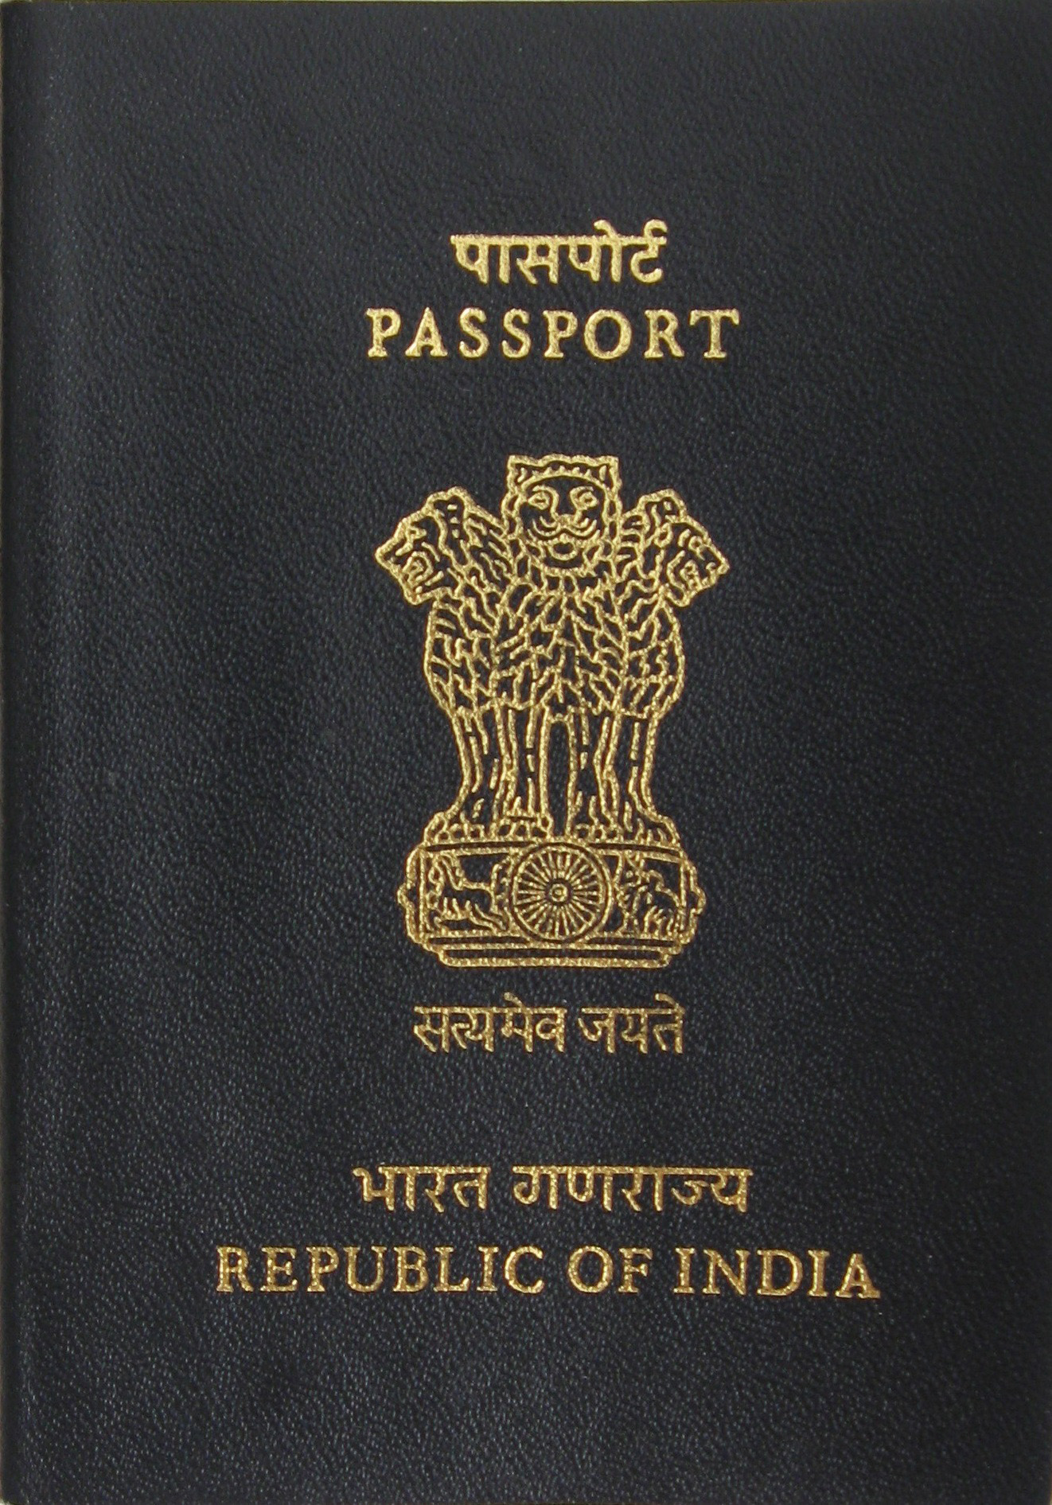
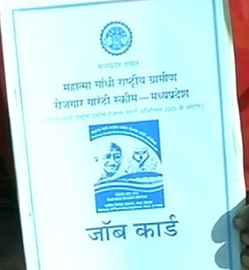

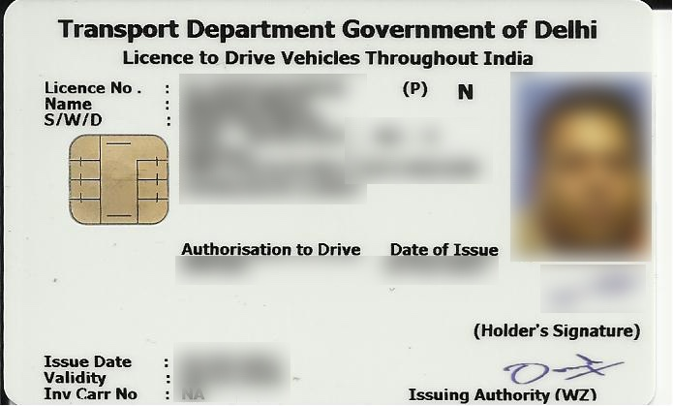
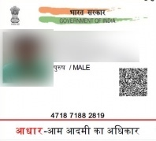
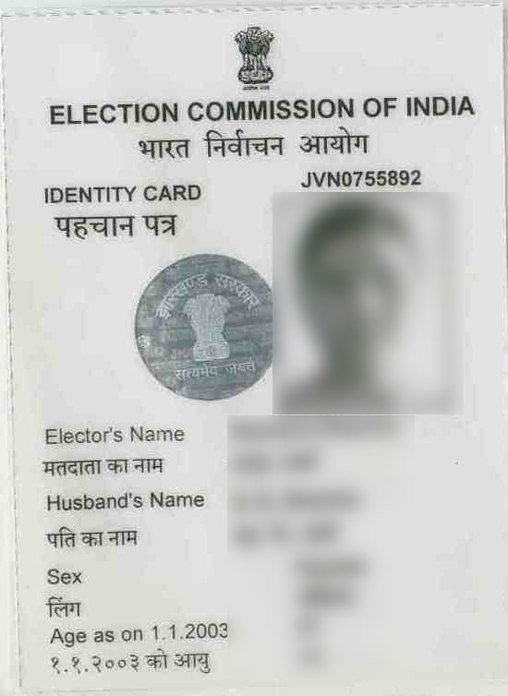
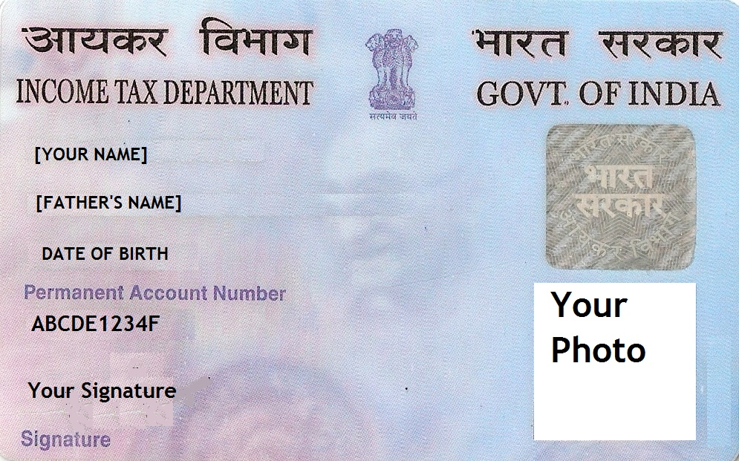
Documents for Opening Accounts
Know Your Customer (KYC): Photo Id Proof, Address Proof, Photo
Officially Valid Documents (Photo Id/Address Proof)
In case of no official documents -
“Small Accounts” can be opened by submitting recent photograph and putting signature or thumb impression in the presence of Bank Official with certain conditions.
Fresh KYC Documents to be submitted on attaining majority, i.e. 18 years in case of minor accounts
Notes:
Add Additional images for the individual items to explain

Slide 7
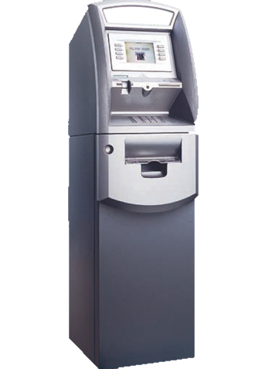
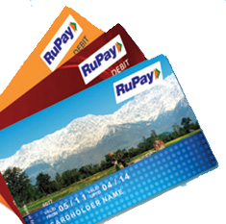
Banking Products
ATM Debit Card
RuPay Debit Card
For cash withdrawal at Automated Teller Machine/Point of Sale (PoS)/Micro ATM through PIN/Password, cashless payment for purchases etc.
Notes:
Divide it in multiple slides :
Saving, Recurring, Fixed
Education Overdraft
ATM
Vidyalaxmi portal

Slide 8



Banking Products
Saving Account
(Basic Saving
Bank Account)
Recurring Account
Fixed Deposit
Monthly savings. Interest paid higher than savings bank account.
Fixed deposit for 7 days to 10 years, higher interest.
Normal transaction, flexibility for deposit and withdraws, passbook and cheque book,etc

Slide 9



Banking Products
Education Loans
Overdrafts
Pursuing Higher/Vocational studies in India maximum Rs. 10 lakhs and abroad Rs 20 lakhs. Or more
Allows withdrawal of money over and above credit balance in accounts up to limit sanctioned on the basis of eligibility
Do You Know?
Students can also register on GOI Vidya Laxmi Portal for Educational Loan application and tracking.
Facts: The rate of interest on Bank loans is very low as compared to money lenders. So, if a money lender mentions 3% interest rate, it means 36% per year whereas if a Bank mentions 12% interest rate, it means 12% per year.
Notes:
Logo of Vidyalaxmi portal

Slide 10
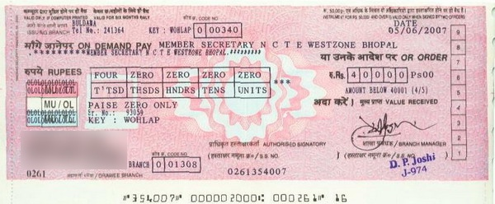
Banking Instruments
Cheque
Demand Draft
Notes:
Add Notification of Chque and MICR No- as in NISM 8th std workbook

Slide 11
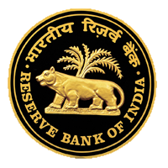
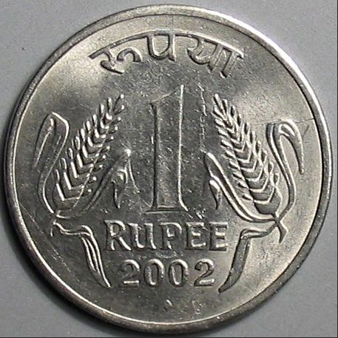
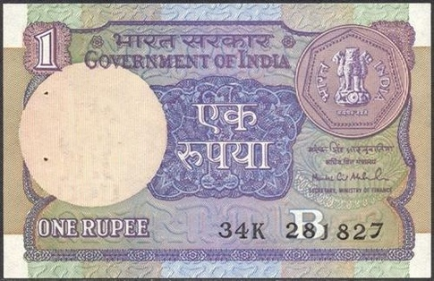
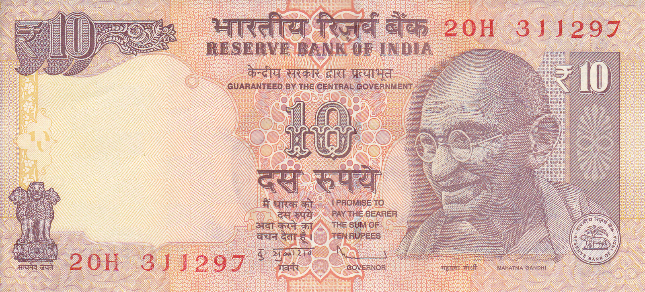
Indian Currency
One Rupee Coin
One Rupee Note
Ten Rupee Note
Do you Know?
10 Rupees and above Note is signed by the Governor of Reserve Bank, while One Rupee Note is signed by the Secretary, Ministry of Finance and the Coin is issued by the GOI Mint

Slide 12
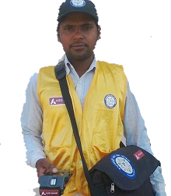
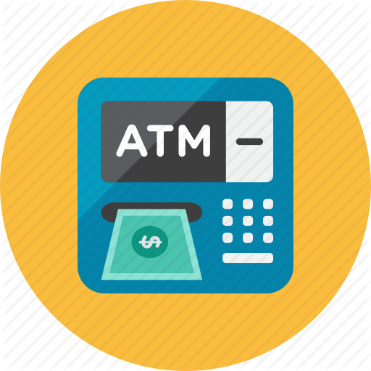
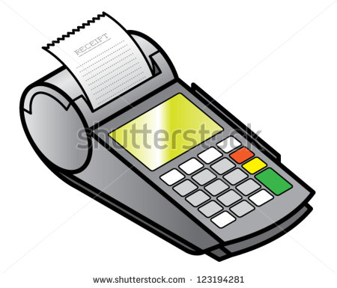

Banking Service Delivery Channels - I
Bank Mitra
with Micro ATM
ATM
Cash Withdrawal through ATM / RuPay Debit Card
Account Opening, Cash Withdrawal / Deposit, Fund Transfer, Insurance
Point of
Sale (POS)
Branch
All Banking Services
Purchasing and limited cash withdrawal
Notes:
Add ATM Video

Slide 13
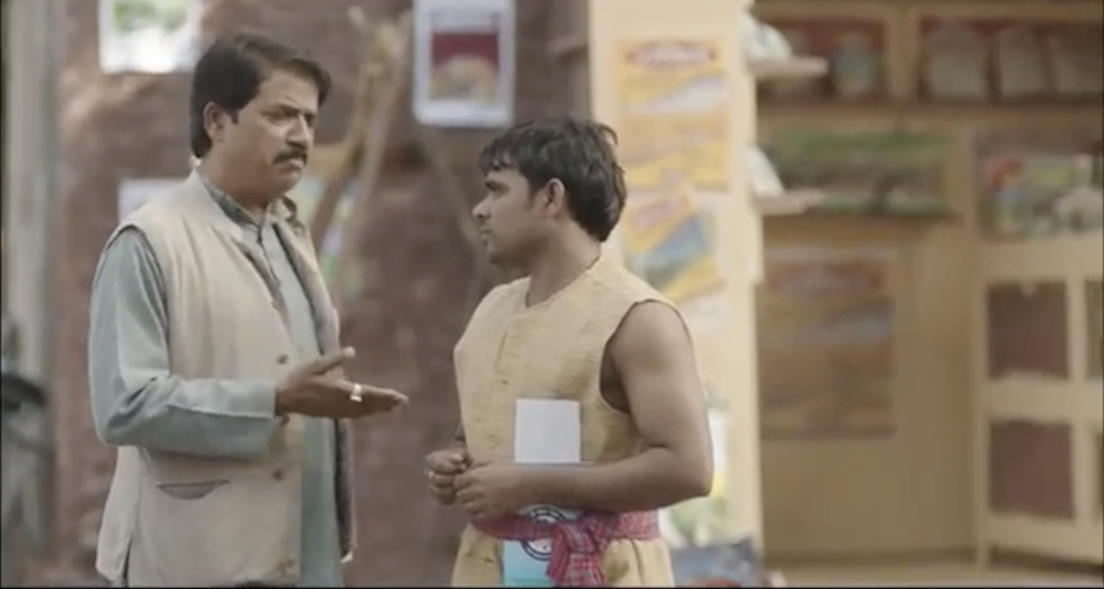
Video - ATM
Play the Video

Slide 14




Banking Service Delivery Channels - II
National Electronic
Fund Transfer (NEFT)
Real Time Gross
Settlement (RTGS)
Mobile Banking
Inter-Bank Transfer of any amount
Inter-Bank Transfer of Rs 2 lac and above.
Fund Transfer , IMPS Bill payment
Mobile wallets
Internet Banking
Mobile based virtual wallet, preloaded certain amount in the account for online and offline spends
Fund Transfer , Bill payment, online shopping ,ticket booking

Slide 15

Pradhan Mantri Jan-Dhan Yojana
Launched by Hon’ble Prime Minister on 28th August 2014.
The scheme focuses on coverage of households in rural and urban areas.
RuPay Debit Card provides in-built Accidental Insurance Cover of Rs 1.00 Lac.
Overdraft facility up to Rs 5000/-

Slide 16
Discussion on Over-Draft, Micro-ATM
Play Video (Bhola – Haria)
Discussion on Video

Slide 17




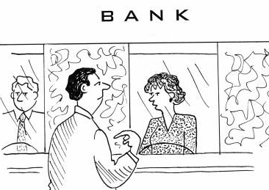
Assign Roles For Next Day Activities
Activity:
Please Work With your Bank Manager to understand all the roles and prepare a small skit based
on the topics discussed and using some of the characters below.
Sample Characters
Bank Manager
Customer
Front Desk Officer
Cashier
Bank Mitra
Sample Skit: A group of 2-3 Students can discuss the importance of opening a bank account and then proceed to branch to open an account. One student can come to withdraw scholarship amount received in his account by filling the withdrawal slip available with the cashier and then inquiring about Education Loan for further Studies.
Assign Roles to Students -> Create Script with them -> Perform the 10-15 min skit in the Next Session

Slide 18
Day 2 Begin
End of Day 1

Slide 19


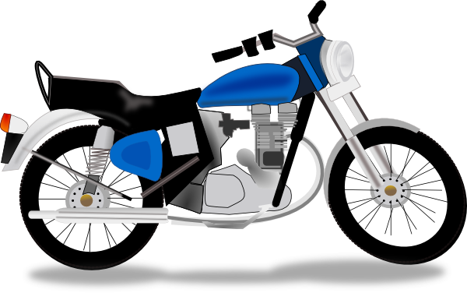

Insurance
Protection against future loss
^{On regular} ^{payments of premium} to insurance company where company promises to pay money up to the insured amount if the person is injured or dies, or to pay money equal to the value of something (such as a house or car) if it is damaged, lost, or stolen.
Life Insurance
Non-Life Insurance

Slide 20
Social Security Schemes
Life insurance coverage of Rs 2 lacs at a premium of Rs 330 /- per annum/ member (Age 18-50)
Assured pension of Rs 1000/- to Rs 5000/- (Age 18-40)
Accidental insurance coverage of Rs 2 lacs at a premium of Rs 12/- per annum/ member (Age 18 – 70)

Slide 21



Pension & Public Provident Fund(PPF)
Pension
A plan for setting aside money to be spent after retirement
PPF
The Public Provident Fund is savings-cum-tax-saving instrument.
It mobilize small savings by offering an investment with reasonable returns combined with income tax benefits.
Quick Check:
Ask your Parents and Grandparents if
they have a pension plan.

Slide 22

Video – PMJDY Influencer
Play the Video

Slide 23
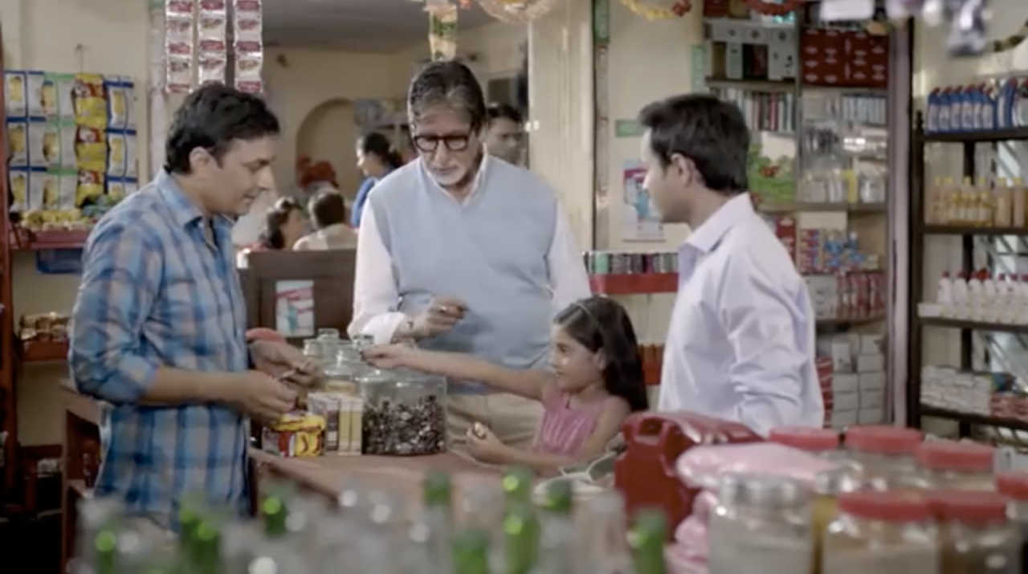
Video: Suraksha Bima Yojana (Grocery)
Play the Video

Slide 24
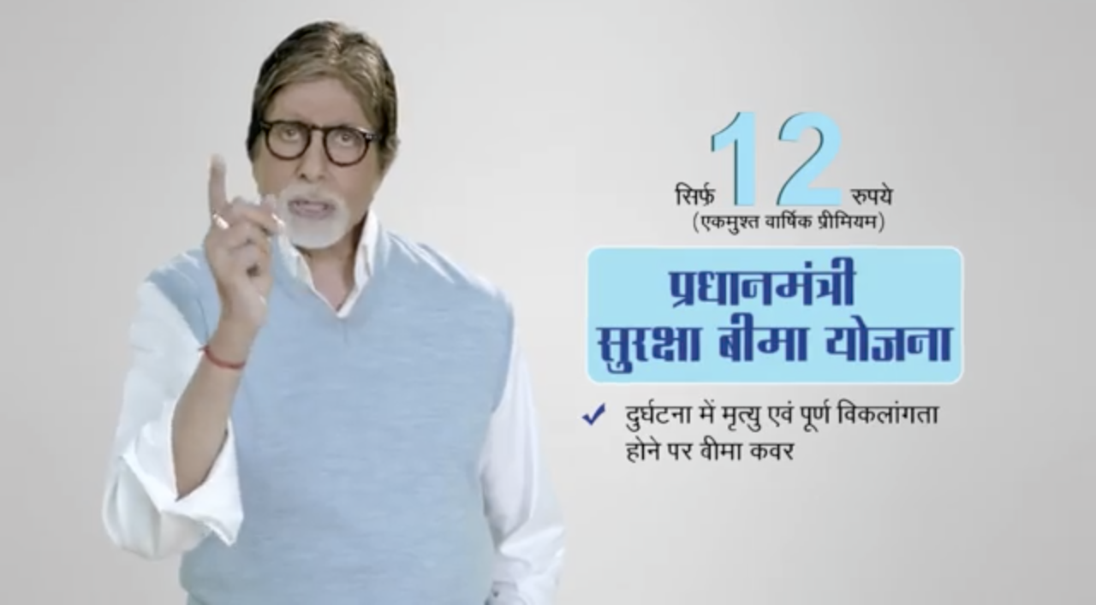
Video: Suraksha Bima Yojana (AutoRickshaw)
Play the Video

Slide 25
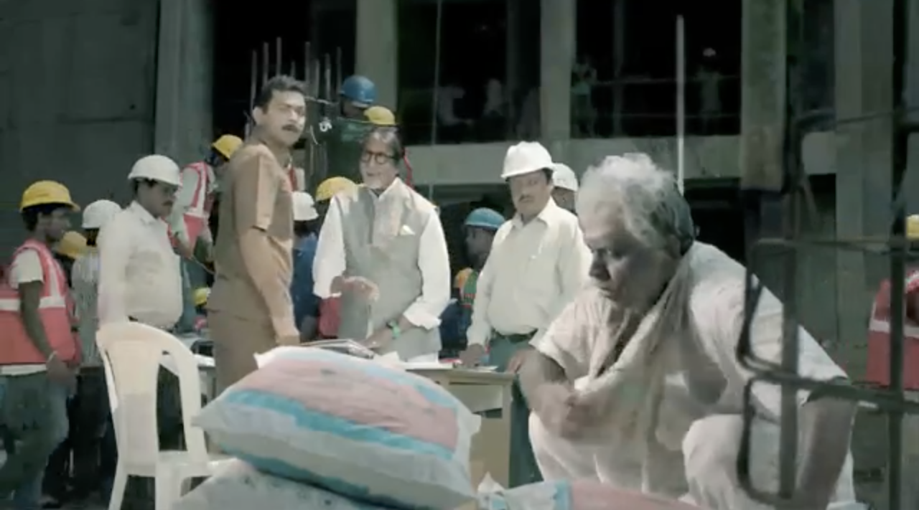
Video: Atal Pension Yojna (APY)
Play the Video

Slide 26
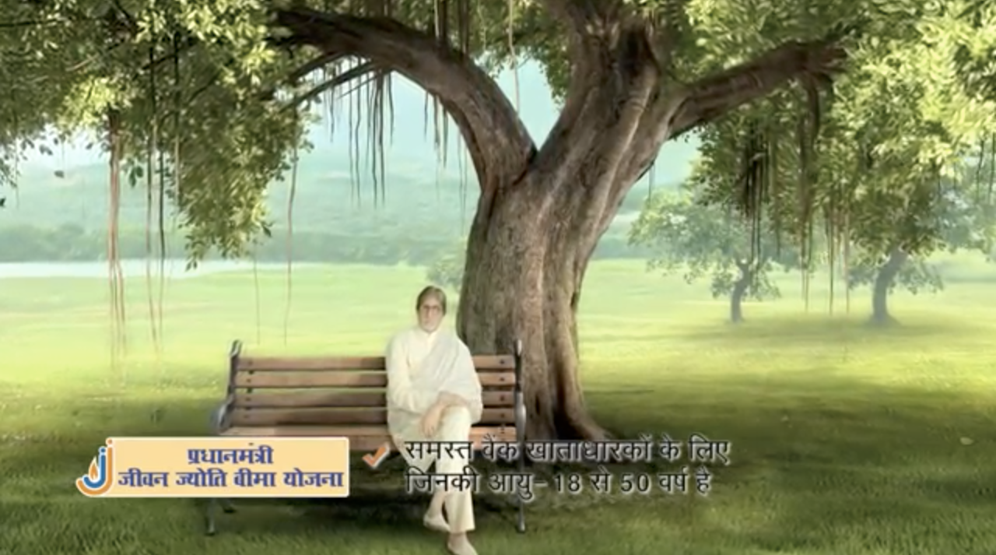
Video: Jeevan Jyoti
Play the Video

Slide 27
Group Activity
Quiz
Prize

